Slide 1

SSID: WWCode
Password: password
Notes:
Please remove this slide when sharing the document to the public

Slide 2




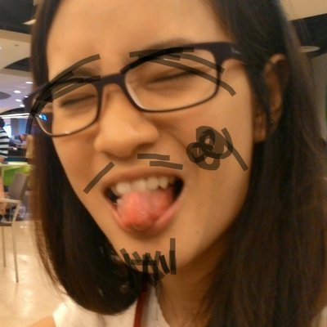




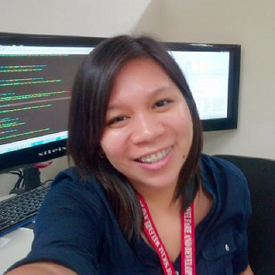


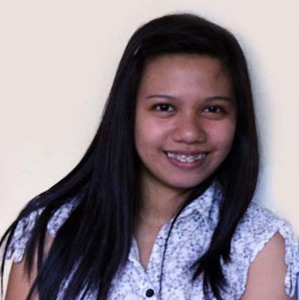
iOS STUDY GROUP
Twitter: @wwcodemanila
FB: fb.com/wwcodemanila
#WWCodeManila
#YourProgrammingLanguage
#StudyGroup

Slide 3
Ciela Salazar
iOS Developer
Sprim
Notes:
Please use only the three colors for the content.

Slide 4
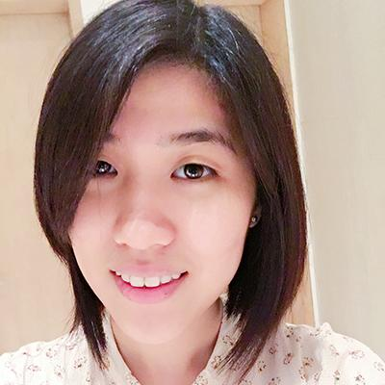
Steffi
iOS Developer
Deal Grocer
Notes:
Please use only the three colors for the content.

Slide 5
New Member’s Introduction

Slide 6

I am <name>
<your current profession>
<why did you join this study group?>
Notes:
Please use only the three colors for the content.

Slide 7
SHOW & TELL
Notes:
Please use only the three colors for the content.

Slide 8
TOPIC FOR TODAY
Notes:
Please use only the three colors for the content.

Slide 9
XCODE AND UI ELEMENTS (OUR FIRST APP 🎉)
Notes:
Please use only the three colors for the content.

Slide 10
Introduction to Xcode
- Xcode is Apple’s IDE for developers to create macOS, iOS, watchOS and tvOS Apps
- It supports development from Objective C and Swift
- currently we will be using Xcode 8.2 for future exercises

Slide 11
Let’s use Xcode
1. Open Xcode from Launchpad or via Spotlight Search
2. Create new project – two ways

Slide 12
First Way

Slide 13
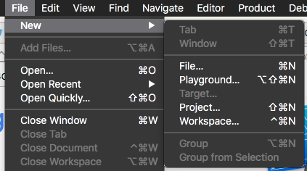
Second Way

Slide 14
3. Choose Template

Slide 15
4. Name Project

Slide 16
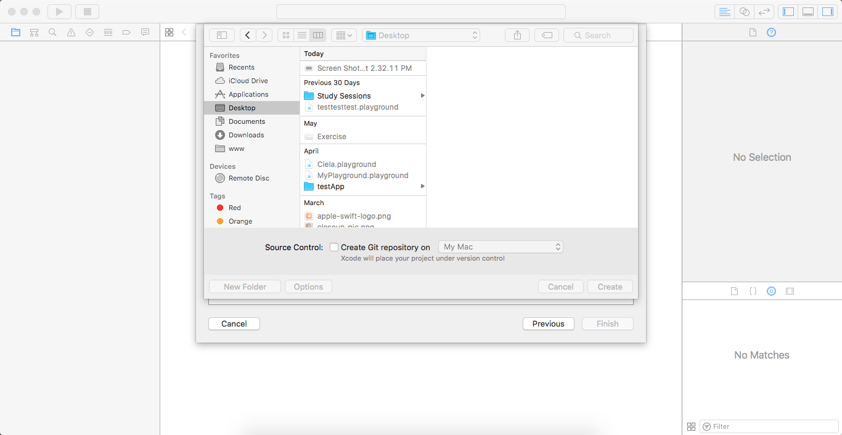
5. Save Project

Slide 18
Project Toolbar

Slide 19
Project Navigator

Slide 20
Utilities

Slide 21
Editor

Slide 22
Debug Area

Slide 24
Document Outline

Slide 25
LET’S CREATE OUR FIRST APP 🎉
Notes:
Please use only the three colors for the content.

Slide 26
Requirements
- Create an app that gets the First and Last Name of the user
- Once user taps on the “Print” button, it will display “Hello [user name]” on the label below

Slide 27
Partner/Group/Individual Exercise
Notes:
Please use only the three colors for the content.

Slide 28
Partner/Group/Individual Presentation
Notes:
Please use only the three colors for the content.

Slide 29
Assignment
Notes:
No required

Slide 30
Add one or any of the following
- Change background and font colors of UI Elements
- Add app image at top of screen
- Add additional Text Fields and button to print age, occupation, Goodbye [user]!

Slide 31
T.I.L.
SHARE IT!
In front!
On Twitter: @wwcodemanila
Or FB: fb.com/wwcodemanila
Don’t forget to tag WWCodeManila so we can retweet or share it.
Notes:
Please use only the three colors for the content.

Slide 32
Feedback Form
https://goo.gl/YzSqcS
Please don’t rate the event on meetup.
Not helpful. It is best to just tell your concerns via the feedback form. We are a building a community not a Yelp restaurant.
Notes:
Please use only the three colors for the content.

Slide 33
THANK YOU :)
Notes:
Please use only the three colors for the content.

